Slide 1

GOVERNMENT OF KARNATAKA
116-GOVERNMENT POLYTECHNIC, K .R. PET
DEPARTMENT OF COLLEGIATE & TECHNICAL EDUCATION
SUBMITTED BY :
AMRUTHA S R
116CE21003
CIVIL ENGINEERING
SEMESTER: VI
UNDER THE GUIDANCE OF:
Ms, CHANDINI
LECTURER , CIVIL DEPARTMENT
GPT, K.R.PETE
MENTOR : MS, JAIKAAR MANJUNATN (A E)

Slide 2
SEWAGE TREATMEMNT PLANT KESARE.

Slide 3
Sewage treatment plant in Mysore City district
Nanjanagud Rayan kere sewage Treatment plant.
Vidyaranyapuram Sewage treatment plant .
Sewage Treatment plant Kesare.

Slide 4
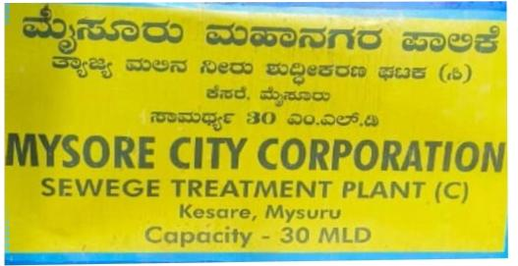
INTRODUCTION TO KESARE SEWAGE TREATMENT PLANT
We take an internship in Mysore city corporation under this organization is responsible for managing the sewage treatment plant in Mysore city
The STP was built on a 25-30 acre plot of the land construction 1998-2002.
A sewage treatment plant is a the treatment plant for drainage district c is of capacity 30.0 MLD and if is located at Kesare Village .
A sewage treatment plant (STP) is a facility designed to remove contaminants and pollutants from wastewater before it is discharged into the environment or reused for non-potable purposes. Sewage is a term used to describe water and waste products that are produced by households, industries, and commercial establishments.

Slide 5
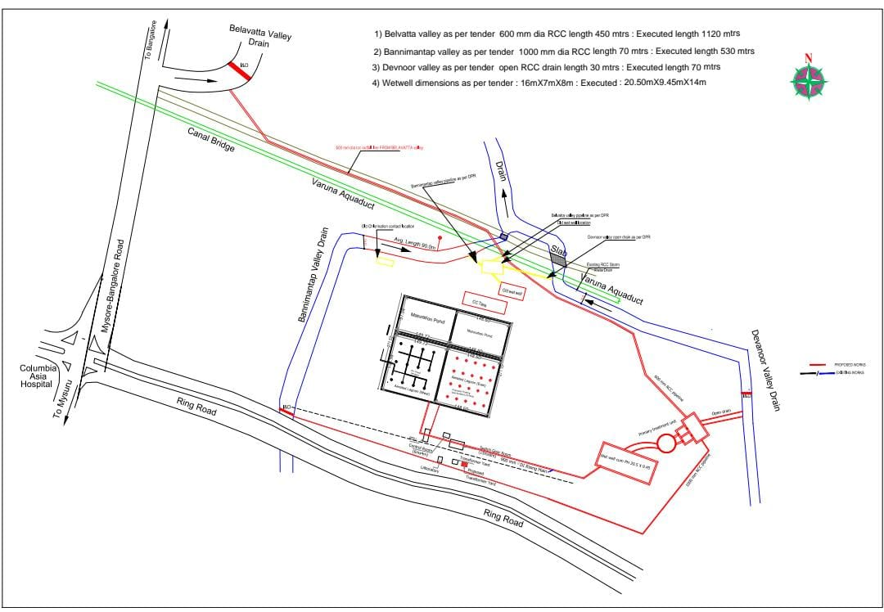
Sewage treatment plant Kesare Mysore Map

Slide 6
Belvatta valley as per 600mm dia, length 112m
Bannimantappa valley as per 1000 mm dia, length 530m
Devanoor valley as per open length 70m

Slide 7
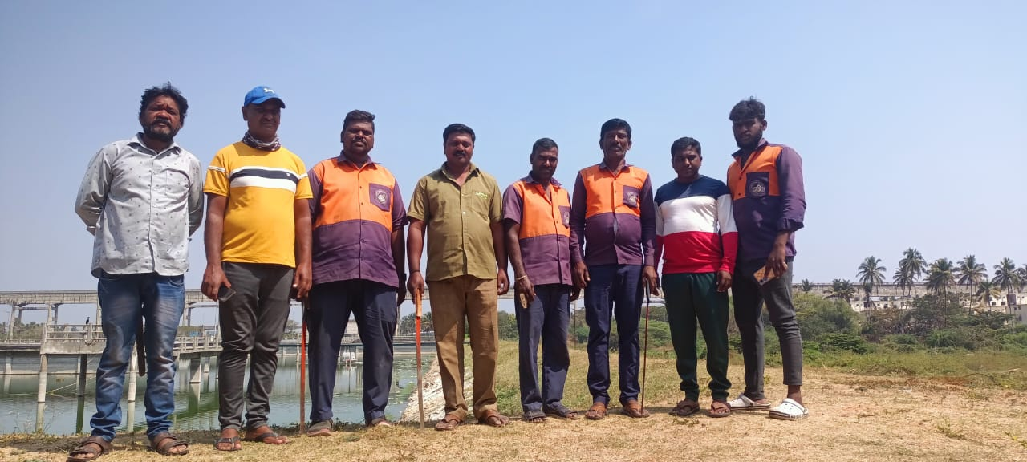
MAINTAINED BY MYSORE CITY CORPORATION STAFF DETAILS
AE :- JAIKAR MANJUNATH
AEE :- NAGARAJE GOWDA.T.G
EE :- NAGARAJAI

Slide 8
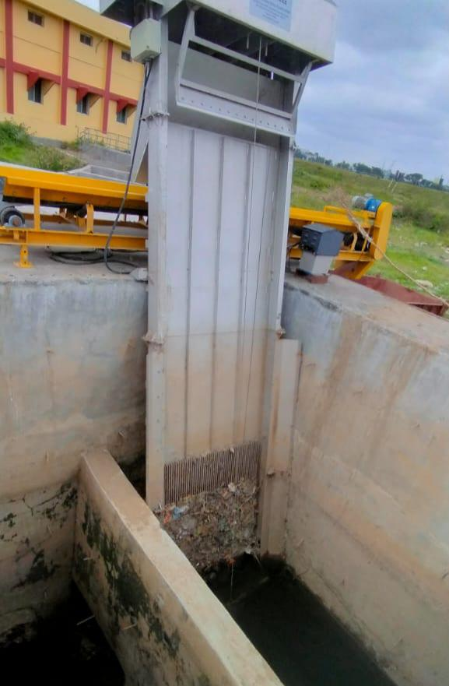
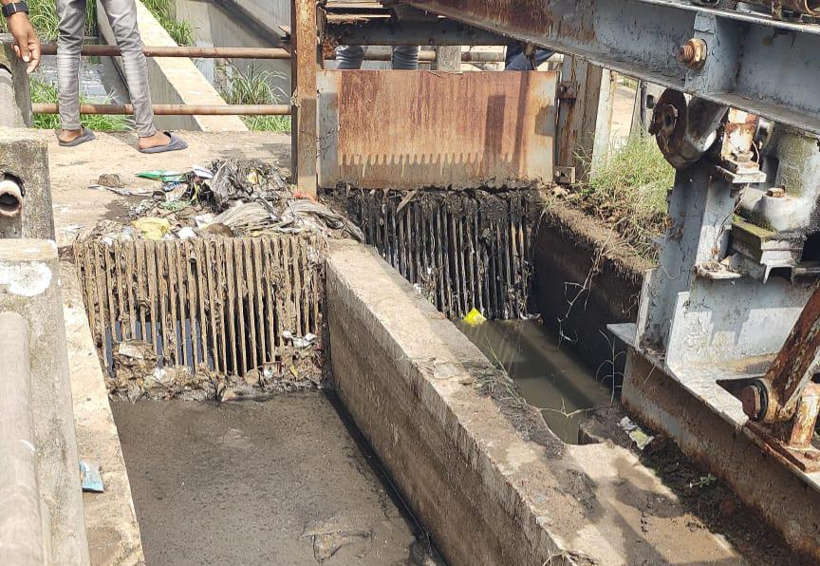
SCREEN
Screening is the first unit operation used at wastewater treatment plants. Screening removes objects such as paper, plastics, wood, glass, bottles and metals to prevent damage and clogging of downstream equipment, piping, and appurtenances.
In our sewage treatment plant uses both manual screening or course screening and machine screening or automatic bar screen.
Manual Screen
Auto mated

Slide 9
Manually and mechanically cleaning
Coarse screen : 25mm
Fine screen: 12mm
Screen inclination : 45degree

Slide 10
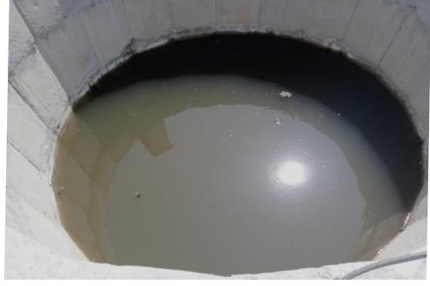
GRIT CHAMBER
General type of grit chamber :horizontal-flow, aerated chambers.
All of these designs allow heavy grit particles to settle out, while lighter, principally organic particles remain in

Slide 11
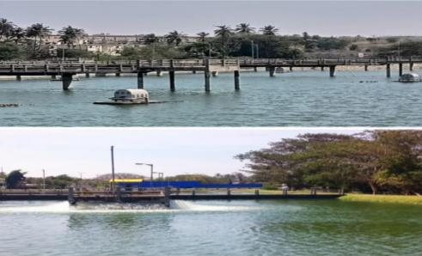
There are 2 type of motor provided in kesare treatment
1. Flotation
2. Aerator
WEST LOGON : L*B*D = 105mm*150mm*3.80m
EAST LOGON : L*B*D = 105mm*150mm*3.80m

Slide 12
THANK YOU

